Slide 1
Scooter city
“A new era in human transportation”
Authors: Alonzo Morales, Mohamed Abdi, Timothy Ayoade, and Chris Miller
A study on the effect of crime rate due to the introduction of dockless motorized scooters

Slide 2
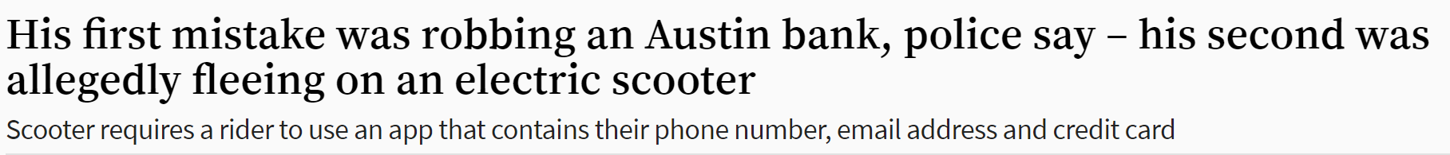
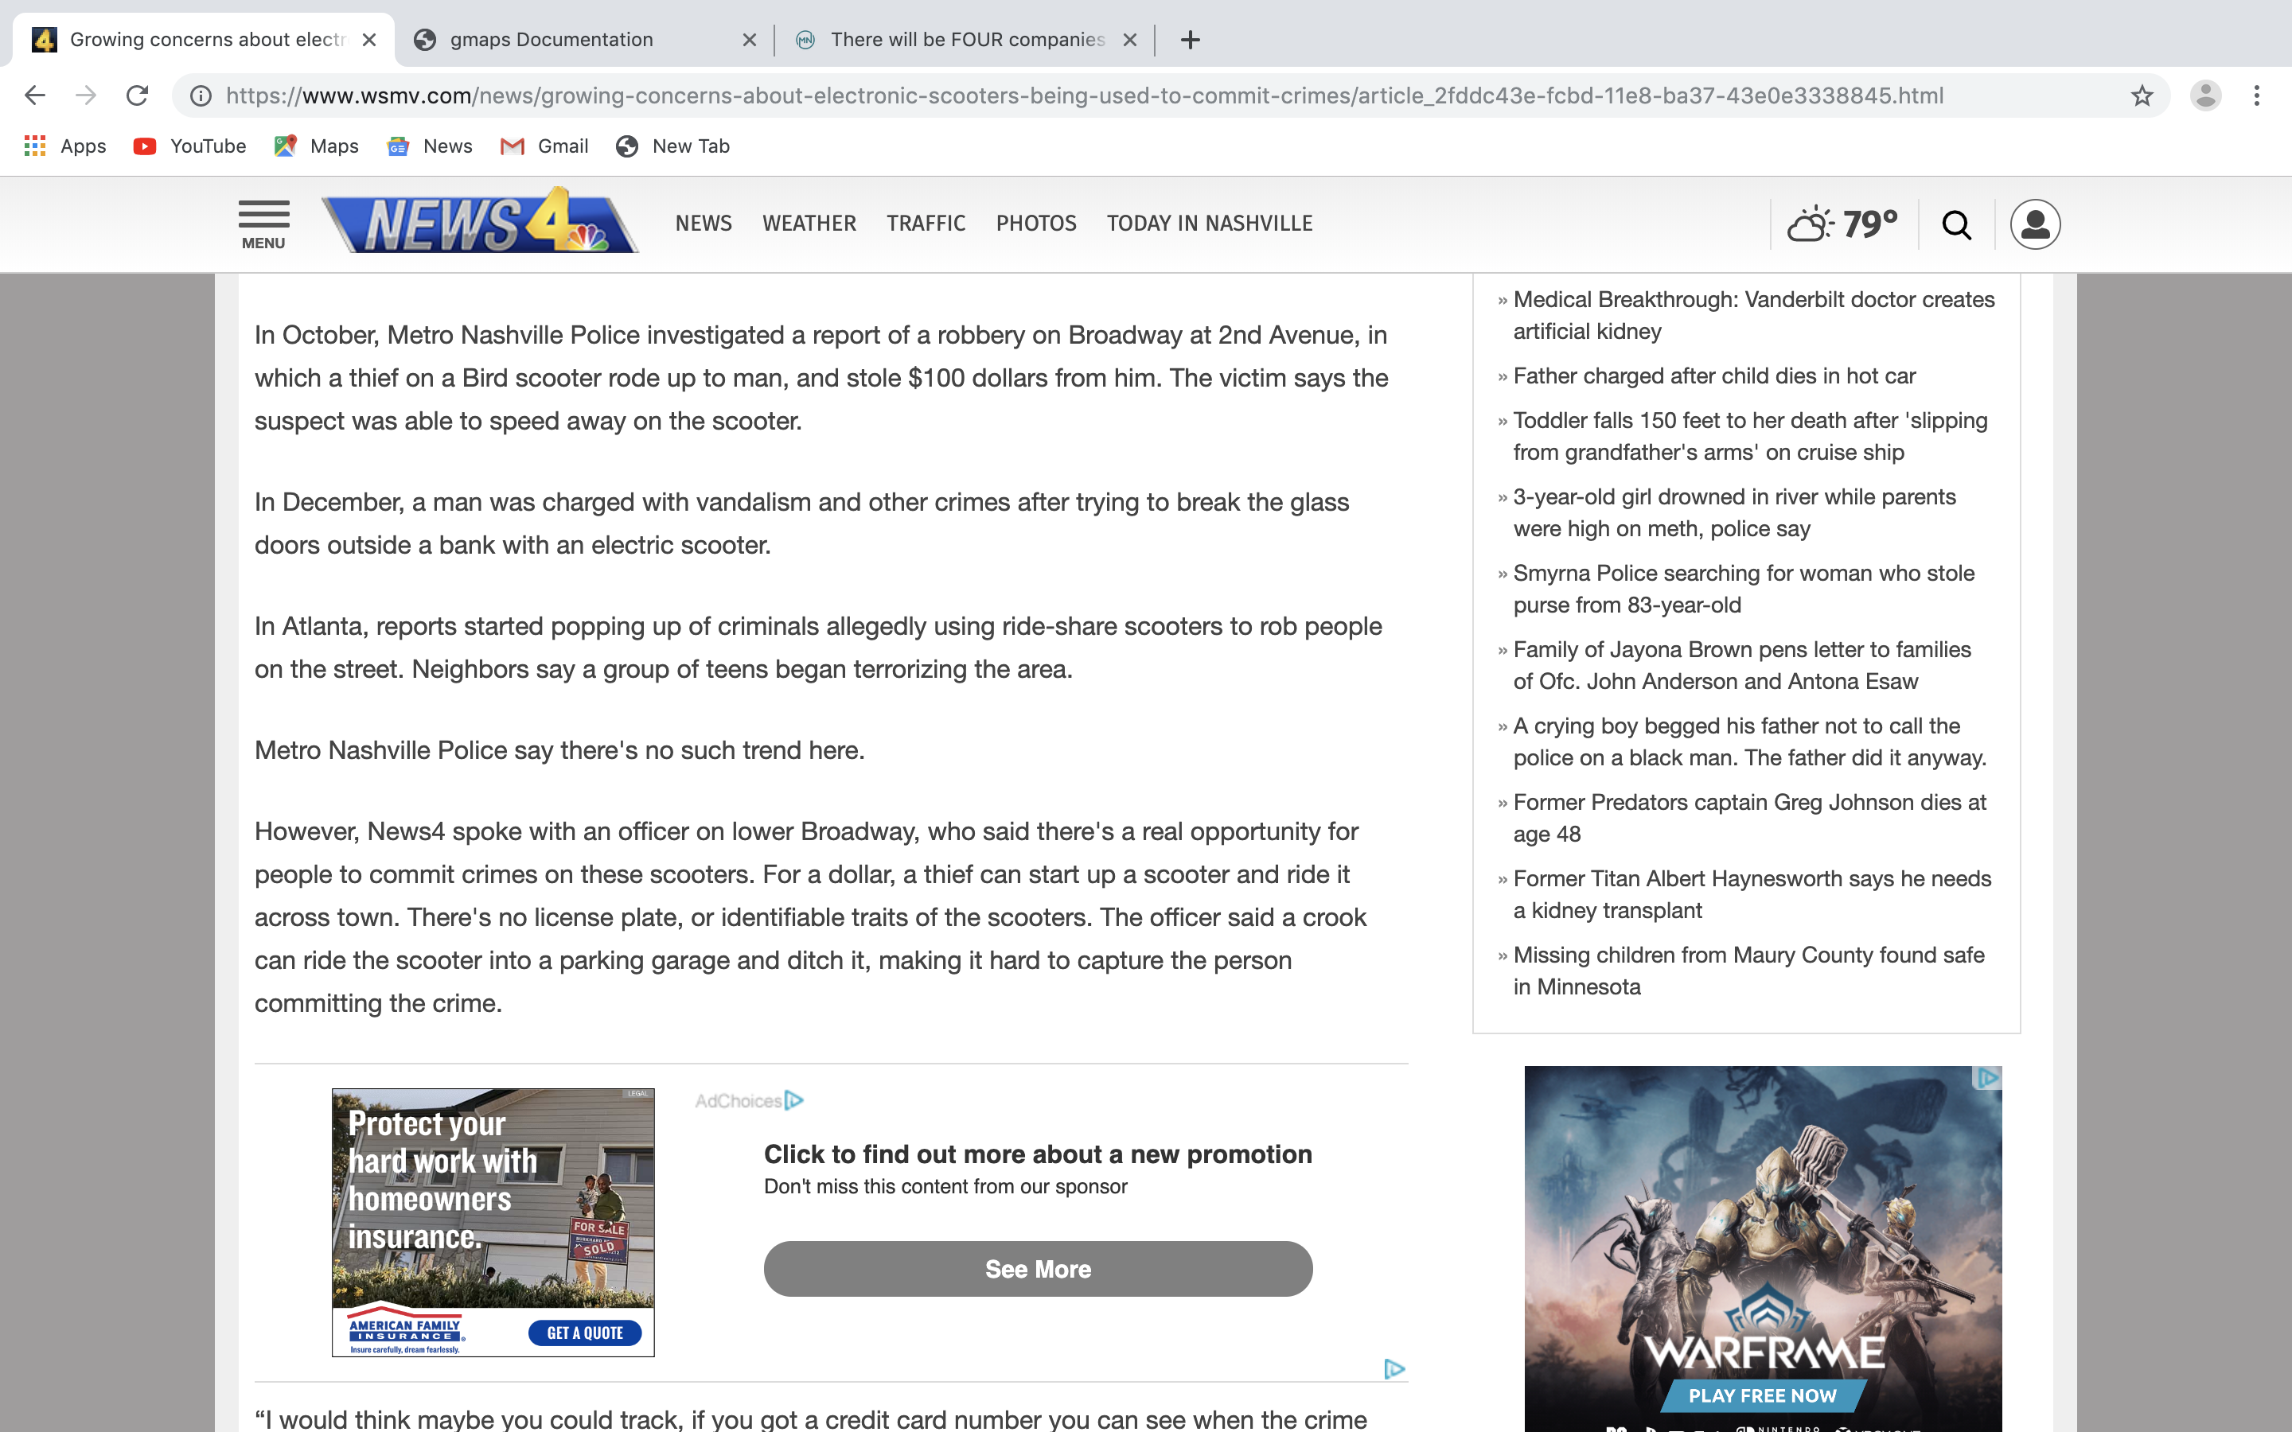
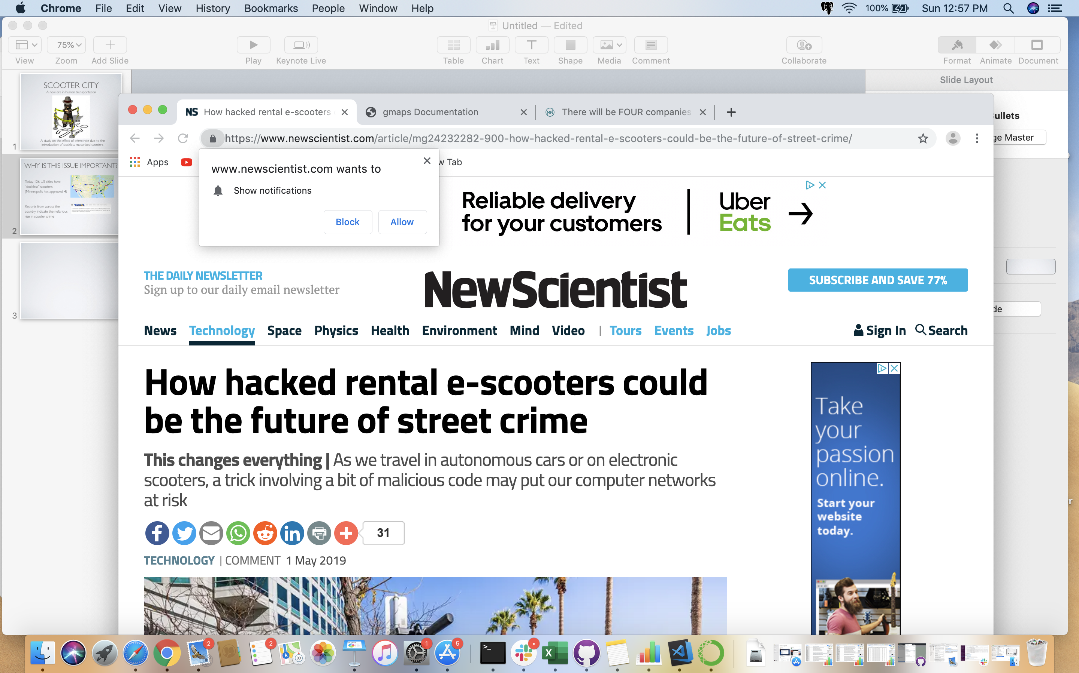
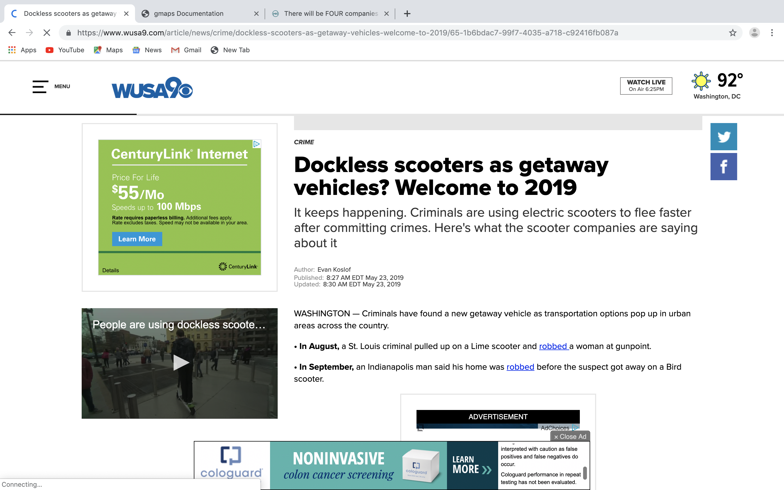
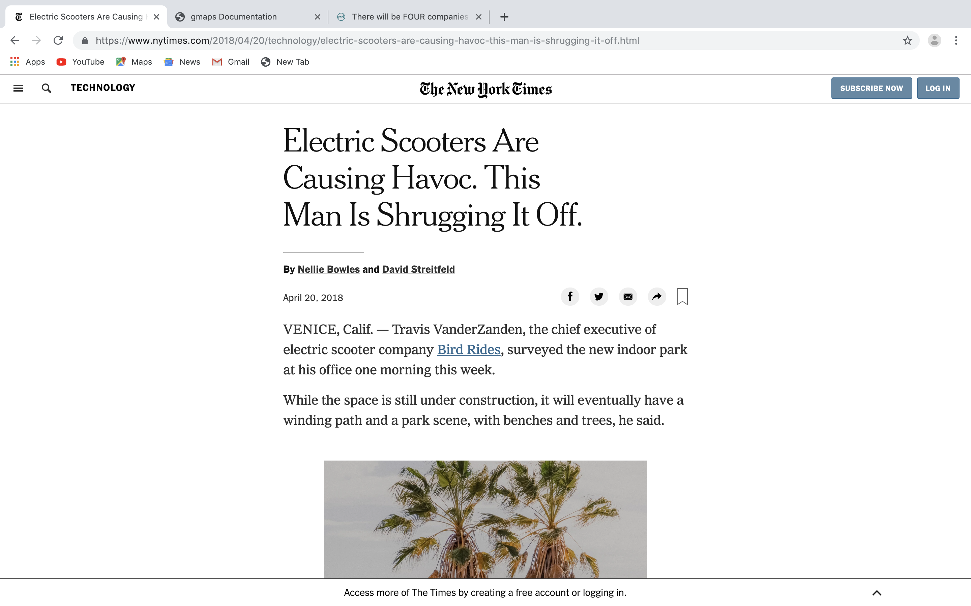
Why is this issue important?
Today, 126 US cities have “dockless” scooter operations
Reports from across the country indicate the nefarious rise in scooter crime
Minneapolis has recently approved dockless scooters

Slide 3
Summary of the study
Our hypothesis is that introduction of dockless scooters has increased the crime rate in Minneapolis.
We found both crime and scooter data via www.opendata.minneapolismn.gov
We determined the relationship between the rate of individual crimes and scooter rental data, and determine whether a correlation existed
Despite the seasonal effect on crime in Minneapolis, we were able to eliminate this phenomenon to determine that petty crimes decreased during the 4 month scooter pilot study.

Slide 4
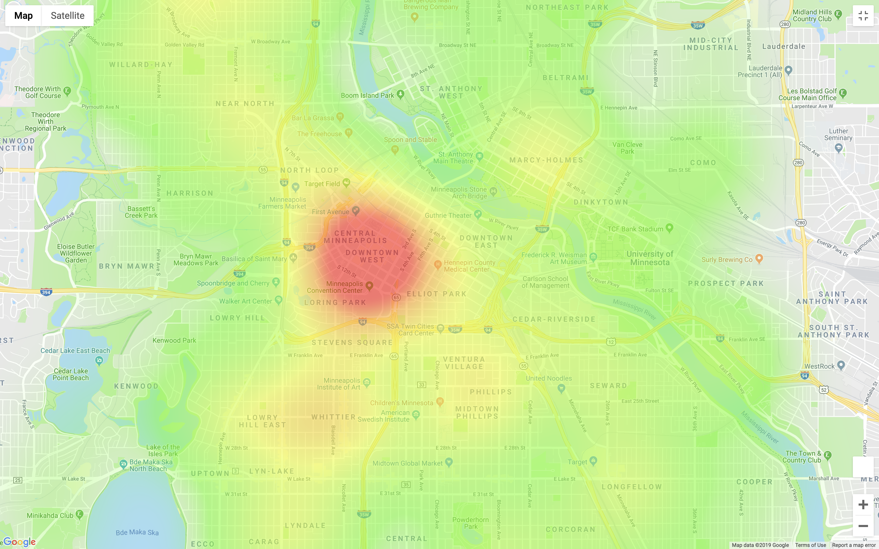
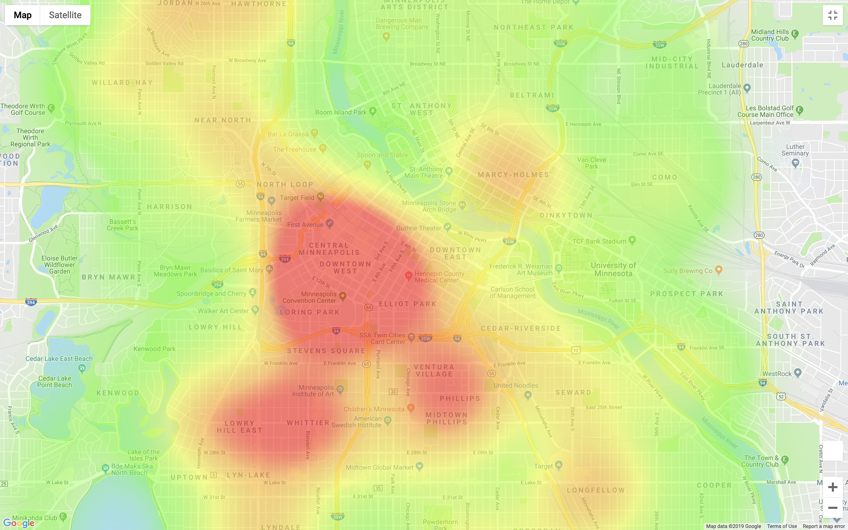
Crime in Minneapolis
Before(2017) vs During(2018)

Slide 5
The proximity to scooters and crime
Does the presence of scooters increase crime rate?
Determine scooter geolocation for start and end trips using Minneapolis scooter data (pilot program: July 10 – November 30, 2018) and Centerline data
Determine crime rate and neighborhood location using Minneapolis crime data

Slide 6
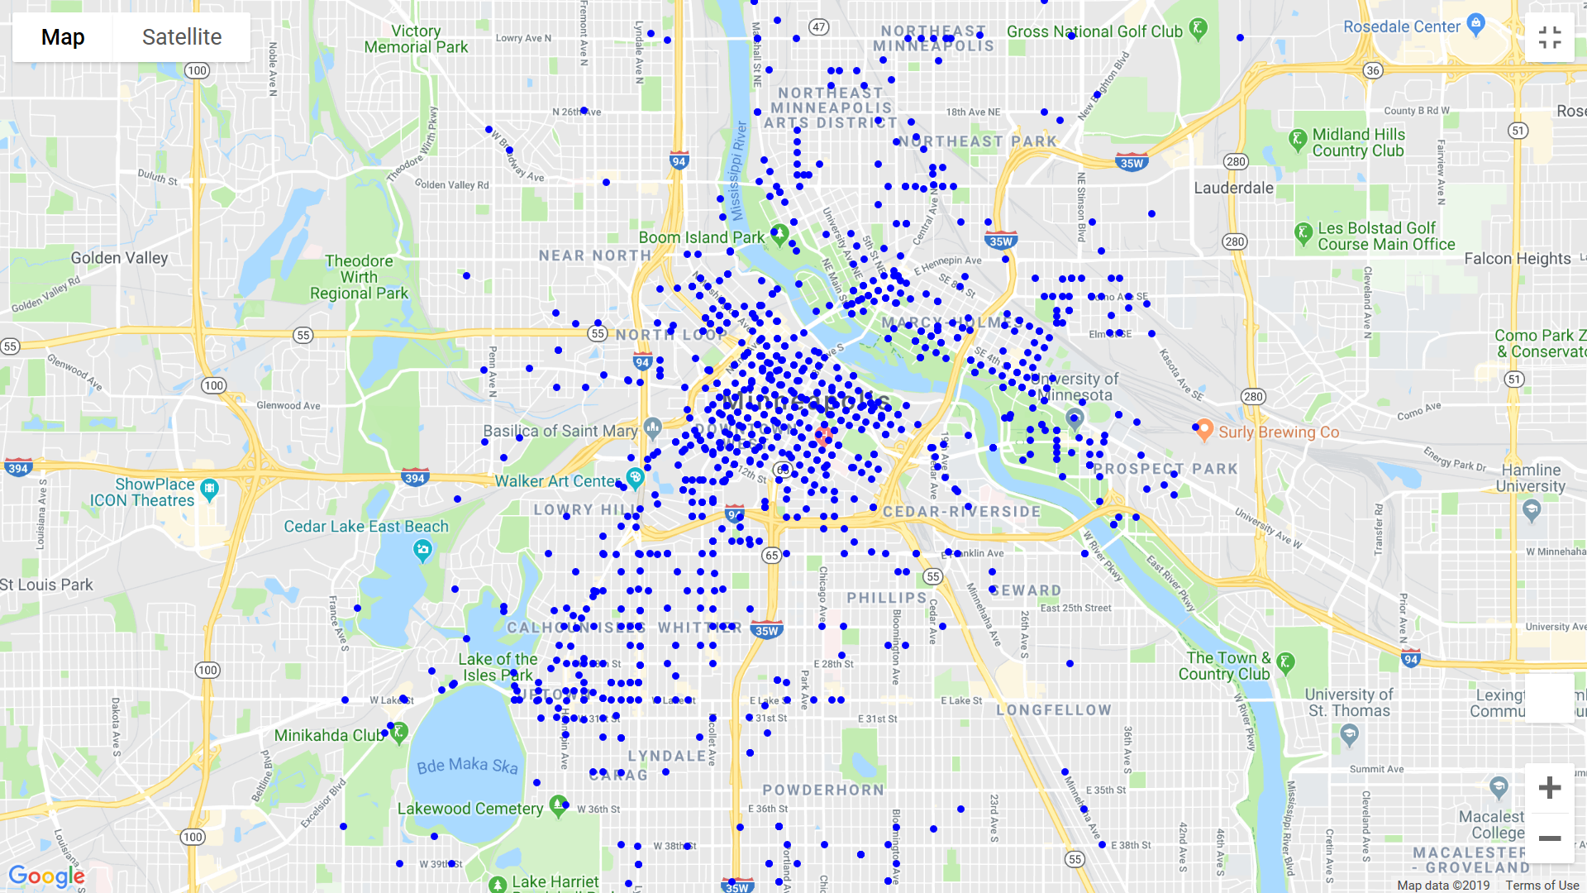
Scooter locations

Slide 7
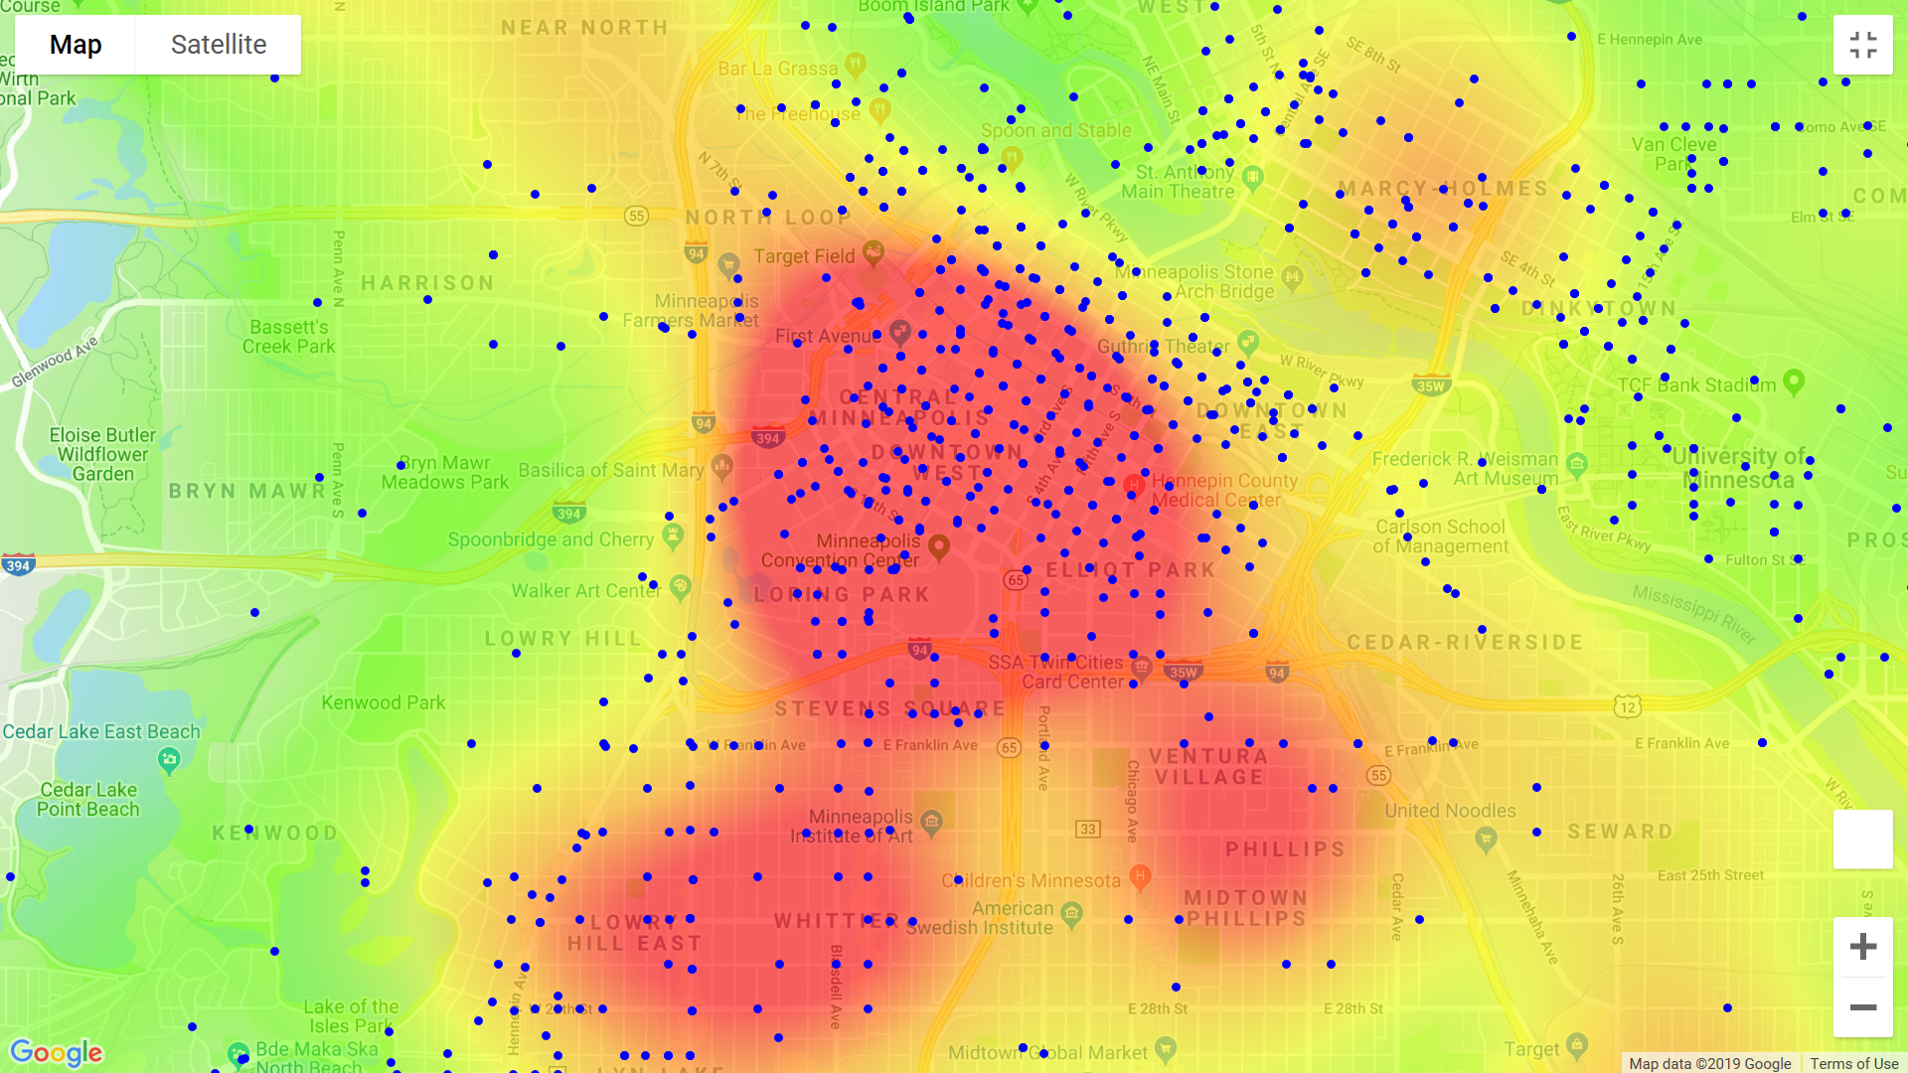
Crime rate and scooters

Slide 8
The seasonal effect on crime in Minneapolis
With Minnesota’s significant change in weather, we wanted to know whether changes in crime rate were influenced by these competing factors
Crime data from 2017 to mid-2019 was grouped by crime type and visualized to determine any trends

Slide 9
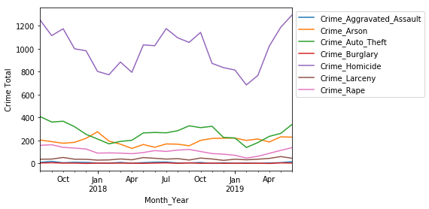
The seasonal effect on crime in Minneapolis

Slide 10
Digging into the numbers
Since the scooter pilot was conducted 8-11, 2018, we opted to compare to this period to the same period the year prior
Adding a “Date” column to the datable to delineate whether the crime happened before or during the scooter trial period (data visualized via Seaborn factor plot (hue = “Date)

Slide 11
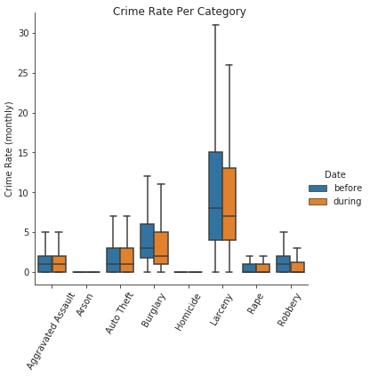
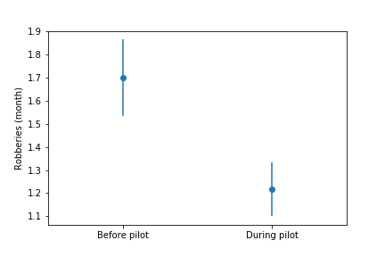
Digging into the numbers
Using numpy ttest, four categories show significant decline (Robbery, AggAssault, Burglary and Arson)

Slide 12
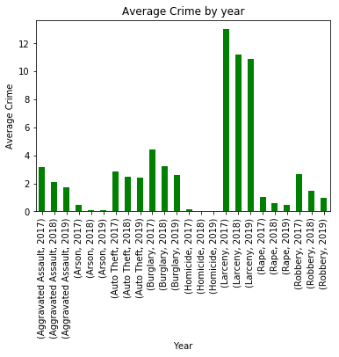
Discussion
We were surprised to find that our hypothesis turned out to be false, crime significantly decreased in four categories, which happen to be “less severe” crimes than the four that didn’t show any effect.
Measuring crime rate by average crime committed monthly in Minneapolis across all neighborhood analyzed; crime decreased in all categories

Slide 13
Post Mortem
Cleaning and reformatting took the majority of the time, (75%)
Our study would have benefited from additional data since crime rates can vary widely over time
If given more time, we would like to explore additional data (i.e. poverty data) and how it relates to crime rates, potentially in other cities where weather doesn’t has a significant effect

Slide 14
Questions?

